Slide 1

CLASS 6 : CSS FLEXBOX

Slide 2
Introduction: Flexbox
Flexbox is a modern, one-dimensional layout model designed to distribute space and align items predictively, even when their sizes are dynamic.
What does "one-dimensional" mean? Flexbox deals with layout in either a row OR a column. You define a direction, and it aligns items along that line. (For two-dimensional rows and columns, you would use CSS Grid, which we'll cover later)

Slide 3
The Flex Container and Flex Items
The Flexbox model involves a parent container and its direct children.
Flex Container: The parent element. You create it by setting “display: flex” on an
element .
Flex items: The direct children of the Flex Container. They automatically become flexible boxes.

Slide 4
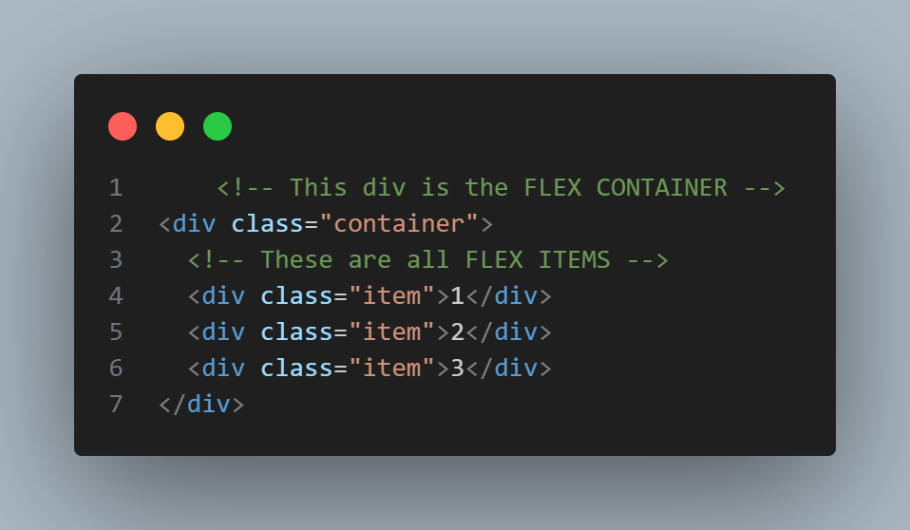
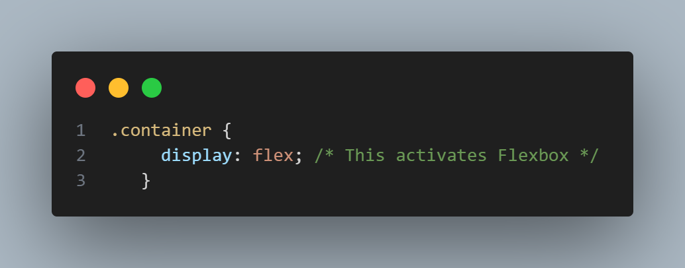
Examples

Slide 5
The Two Axes: Main and Cross
Main Axis: The primary axis along which flex items are laid out. Its direction is defined by “flex-direction”
Main Start / Main End: The start and end points of the main axis
Main Size: The width or height of a flex item, whichever is in the direction of the main axis.
Cross Axis: The axis perpendicular to the main axis.
Cross Start / Cross End: The start and end points of the cross axis.
Cross Size : The width or height of a flex items, whichever is in the dimension of the cross axis
The key takeaway: justify-content align items along the main axis. Align items aligns items along the cross axis

Slide 6
Flex Container Properties
flex-direction: These properties are set on the parent (the flex container)
Defines the direction of the main axis
row (default): Left to right. Main axis = Horizontal.
row-reverse: Right to left. Main axis = Horizontal.
column: Top to bottom. Man axis = Vertical.
column-reverse: Bottom to top. Main axis = Vertical.
flex-wrap: By default, flex items will try to fit all on one line. This property allows them to wrap onto multiple lines
nowrap (default): All items on one line.
wrap: items onto multiple line from top to bottom
wrap-reverse: items wrap onto multiple line from bottom to top

Slide 7
Flex Container Properties
justify-content: Defines how the browser distributes space along the main axis between and around flex items.
Value | Behavior (Main axis)
flex-start | Items are packed toward the start of the axis
flex-end | Items are packed toward the end of the axis
center | Items are centered along the axis.
space-between | Items are evenly distributed; first item at start, last at end
space-around | Items are evenly distributed with equal space around them.
space-evenly | Items are distributed so the spacing between any two is equal.

Slide 8
Flex Container Properties
align-items: Defines how space is distributed along the cross axis for a single line of items. It sets the default alignment for all flex items.
Value | Behavior (Main axis)
stretch | Items stretch to fill the container's cross size.
flex-start | Items are placed at the start of the cross axis.
flex-end | Items are placed at the end of the cross axis.
center | Items are centered along the cross axis
baseline | Items are aligned based on their text's baseline.

Slide 9
Flex Items Properties
These properties are set on the children (the flex items).
flex-grow: Defines the ability for a flex item to grow if necessary. It accepts a unitless value that serves as a proportion. It dictates what amount of the available space inside the flex container the item should take up.
Default is 0 (will not grow). if all items have flex-grow: 1, they will share the space equally, if one item has flex-grow: 2, it will take up twice the available space as the others (1 vs. 1 vs. 2)
flex-shrink: Defines the ability for a flex item to shrink is necessary. Default is 1.
flex-basis: Defines the default size of an element before the remaining space is distributed. It can be length (e.g., 20%, 5rem, 200px) or auto (default).
Shorthand: ‘flex”, the recommended shorthand for flex-grow, flex-shrink and flex-basis

Slide 10
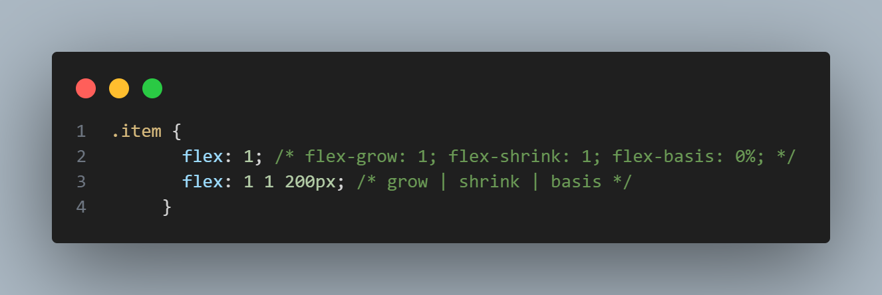
Flex Items Properties

Slide 11
Flex Items Properties
align-self: Allows the default alignment (or the one specified by align items) to be overridden for the individual flex items. (uses the same values as “align-items: auto, flex-start, center, etc.)
order: Controls the visual order of items without affecting the HTML source order. Default is 0. items with a higher order value will appear later. Items with the same value are ordered by source.

